Slide 1
Approval Testing
Exercise:
- Retrospective

Slide 2
Exercise 1
1. Wrote test for functional code
2. Go to 1
Notes:
Before, we did new stuff, new stuff… we are now doing the same thing many different ways

Slide 3
Exercise 2
1. Capture things with Approvals
2. Capture everything
3. Capture informative output
4. Call a list of inputs
5. Call a combination from 2 inputs
Homework: Method pointers as input

Slide 4
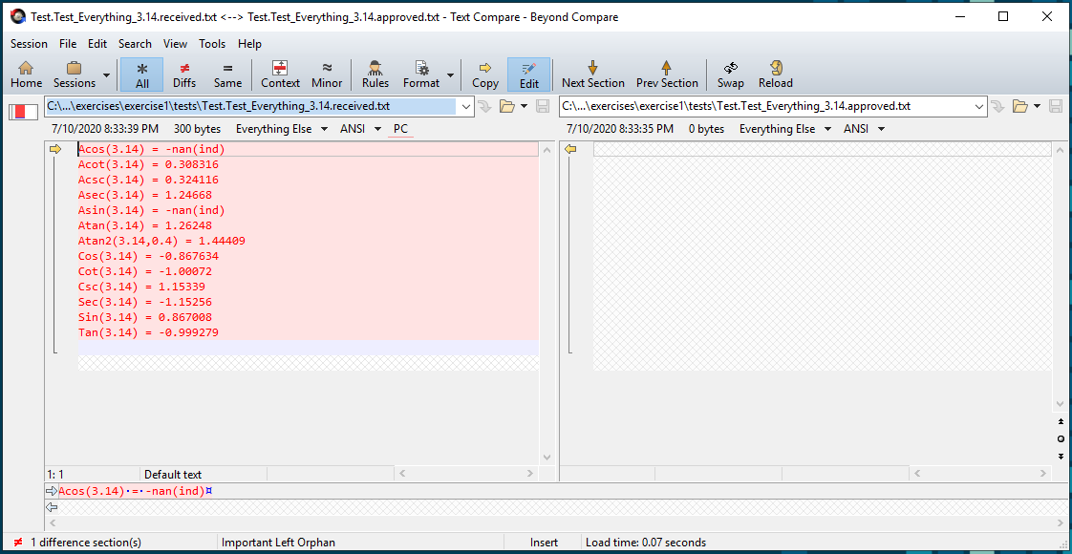
1. Capture things with Approvals
Actual
Expected
FileName.TestName.Received.txt
FileName.TestName.Approved.txt

Slide 5
2. Capture everything
0
0.828807
0.785398
1.5708
0
1.5708
0.785398
0.828807
8.54019
10.3042
1
1.20655
0.0970479
0.117093
std::string doEverything(double value)
Notes:
Basic locking – limited info

Slide 6
3. Capture informative output
0.828807 vs Sin = 0.828807 vs Sin(1.0) = 0.828807
Notes:
How can we make the output more helpful if there is a failure

Slide 7
4. Call a list of inputs
std::vector < double> inputs1 = { -0.1, 0.0, 1.0, 3.14 };
Notes:
Test a whole bunch of inputs at once

Slide 8
5. Call a combination from 2 inputs
X | -1.1 | 0.0 | 2.2 | 3.3
-1.1 | {-1.1, -1.1} | {0.0, -1.1} | {2.2, -1.1} | {3.3, -1.1}
0.0 | {-1.1, 0.0} | {0.0, 0.0} | {2.2, 0.0} | {3.3, 0.0}
2.2 | {-1.1, 2.2} | {0.0, 2.2} | {2.2, 2.2} | {3.3, 2.2}
3.3 | {-1.1, 3.3} | {0.0, 3.3} | {2.2, 3.3} | {3.3, 3.3}
Notes:
Cross product of combinations

Slide 9
Homework: Method pointers as input
std::map <std::string, TrigMathMemFn> inputs1 {
{ "Acos", &TrigMath::Acos },
{ "Acot", &TrigMath::Acot },
{ "Acsc", &TrigMath::Acsc },
{ "Asec", &TrigMath::Asec },
{ "Asin", &TrigMath::Asin },
{ "Atan", &TrigMath::Atan },
{ "Cos", &TrigMath::Cos },
{ "Cot", &TrigMath::Cot },
{ "Csc", &TrigMath::Csc },
{ "Sec", &TrigMath::Sec },
{ "Sin", &TrigMath::Sin },
{ "Tan", &TrigMath::Tan }
};

Slide 10
Printers

Slide 11
Show the Data, Show the Difference
- Edward Tufte (Author of “The Visual Display of Quantitative Information”)
Notes:
Design: We want our printing to make it easy to understand differences

Slide 12
// Create side (0,0) – (3,4)
// Verify length
Whiteboard
English
Testing Circle
Result
Code
Side (0,0) – (3,4) length = 5
Side s = new Side(0,0,3,4);
Approvals.Verify(s + " length = " +s.Length);
Notes:
We want something that reminds us of what was on the whiteboard
Approved output persists – whiteboard disappears

Slide 13
Benefits of Unit Tests
Specification
Feedback
Regression
Granularity
Notes:
Now we can start thinking about granularity and specification
Showing inputs helps to show specification
And it helps to see what’s changed with granularity

Slide 14
Telling a Story
Checking Trig Functions in main areas
Acos(-0.1) = 1.67096
Acot(-0.1) = 1.67046
Acsc(-0.1) = nan
Asec(-0.1) = -nan(ind)
Asin(-0.1) = -0.100167
Atan(-0.1) = -0.0996687
Atan2(-0.1,0.4) = -0.244979
Cos(-0.1) = 0.0332319
Cot(-0.1) = -0.339801
Csc(-0.1) = -10.2251
Sec(-0.1) = 30.0915
Sin(-0.1) = -0.0977983
Tan(-0.1) = -2.9429
Acos(0) = 1.5708
Acot(0) = -nan(ind)
Acsc(0) = -nan(ind)
Asec(0) = -nan(ind)
Asin(0) = 0
Atan(0) = 0
Atan2(0,0.4) = 0
Cos(0) = 0.00854503
Cot(0) = inf
Csc(0) = inf
Sec(0) = 117.027
Sin(0) = 0
Tan(0) = 0
Acos(0.2) = 1.36944
Acot(0.2) = 1.3734
Acsc(0.2) = -nan(ind)
Asec(0.2) = -nan(ind)
Asin(0.2) = 0.201358
Atan(0.2) = 0.197396
Atan2(0.2,0.4) = 0.463648
Cos(0.2) = 0.0977983
Cot(0.2) = 1.49915
Csc(0.2) = 15.329
Sec(0.2) = 10.2251
Sin(0.2) = 0.0652359
Tan(0.2) = 0.667046
Acos(0.8) = 0.643501
Acot(0.8) = 0.896055
Acsc(0.8) = -nan(ind)
Asec(0.8) = -nan(ind)
Asin(0.8) = 0.927295
Atan(0.8) = 0.674741
Atan2(0.8,0.4) = 1.10715
Cos(0.8) = 0.867571
Cot(0.8) = 88.5131
Csc(0.8) = 102.024
Sec(0.8) = 1.15264
Sin(0.8) = 0.00980161
Tan(0.8) = 0.0112978
Acos(1) = 0
Acot(1) = 0.785398
Acsc(1) = 1.5708
Asec(1) = 0
Asin(1) = 1.5708
Atan(1) = 0.785398
Atan2(1,0.4) = 1.19029
Cos(1) = 0.828807
Cot(1) = 8.54019
Csc(1) = 10.3042
Sec(1) = 1.20655
Sin(1) = 0.0970479
Tan(1) = 0.117093
Acos(3.14) = -nan(ind)
Acot(3.14) = 0.308316
Acsc(3.14) = 0.324116
Asec(3.14) = 1.24668
Asin(3.14) = -nan(ind)
Atan(3.14) = 1.26248
Atan2(3.14,0.4) = 1.44409
Cos(3.14) = -0.867634
Cot(3.14) = -1.00072
Csc(3.14) = 1.15339
Sec(3.14) = -1.15256
Sin(3.14) = 0.867008
Tan(3.14) = -0.999279
Notes:
You can see some of the specification here
6 groupings
We are using 6 different input values for these 12 functions

Slide 15
Seeing a Story
TEST_CASE("Graphing")
{
std::stringstream s;
TrigMath math;
for ( double i = 0; i <= 6.28; i += 0.01)
{
s << i << ',' << math.Sin(i) << '\n';
}
Approvals::verify(
s.str(),
Options().fileOptions().withFileExtension(".csv"));
}
Notes:
Can we visualise the story?

Slide 16
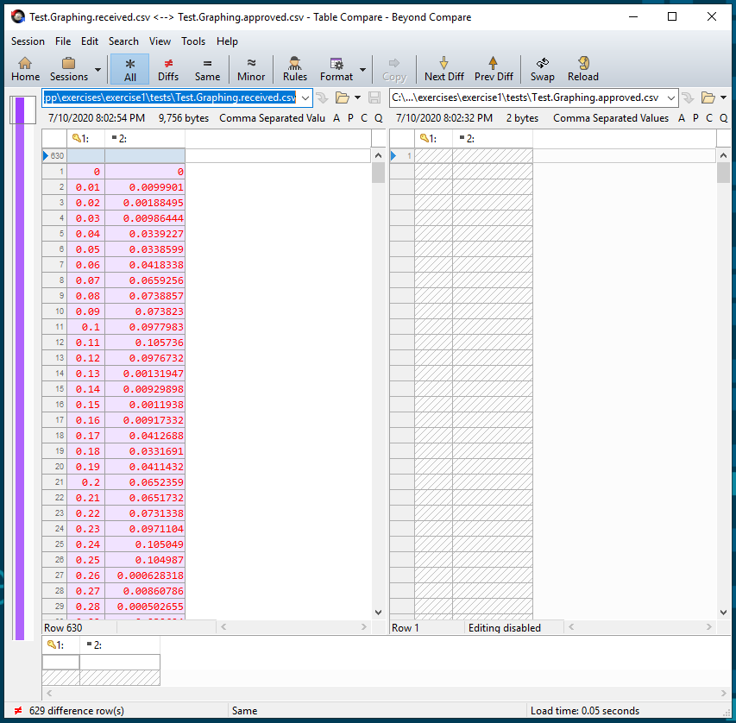
Seeing a Story

Slide 17
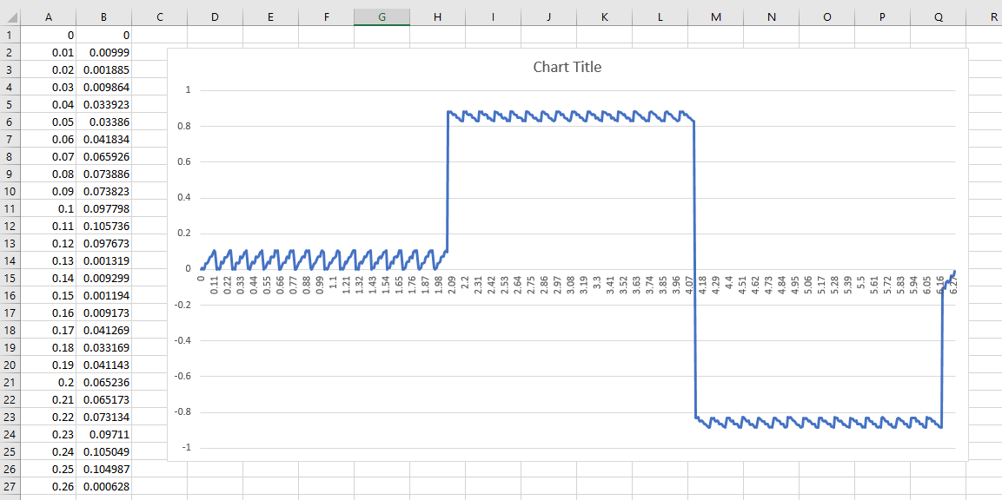
Seeing a Story

Slide 18
Arrange Act Assert
Notes:
Typical explanation of parts of a unit test

Slide 19
Arrange Act Assert
Given When Then
Notes:
The BDD parts (Behaviour Driven Development)
Equivalent

Slide 20
Arrange Act Assert
Given When Then

Slide 21
#1
TEST_CASE("Test Setup") {
TrigMath math; // Arrange
REQUIRE(math.DEG_TO_RAD == Approx(0.0174532925)); // Assert
}
#2
TEST_CASE("Test Function") {
auto result = pow(2, 3); // Act
REQUIRE(result == Approx(8)); // Assert
}
Notes:
Not everything has all 3 parts
Though Assert is required!

Slide 22
Arrange Act Assert
Given When Then
Notes:
You must have at least an arrange or an act.
Can’t just have an assert.

Slide 23
Do Verify
Notes:
So we think of it as…

Slide 24
Stages of Approvals::verify()
verify()
writes "received"
Same?
Pass
Fail
Reporter
object
reads "approved"
Notes:
What’s actually happening with Approvals

Slide 25
Types of Fialure Failuer Change
Improvement
Bug
Change the code
Change the test
Fail
Notes:
There are two types of test failure
The code has been improved
You have introduced a bug

Slide 26
Homework

